Slide 1
Explanation
高怡
51205901034
gaoyi@stu.ecnu.edu.cn
1
Notes:
作者单位

Slide 2
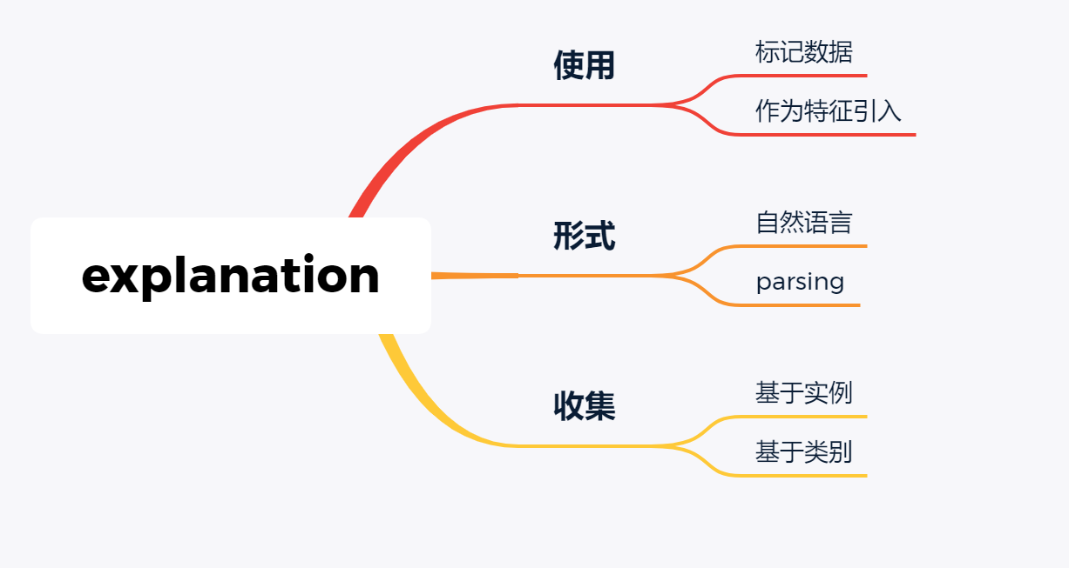
概述

Slide 3

[ACL18]Training Classifiers with Natural Language Explanations
3
Notes:
作者单位

Slide 4
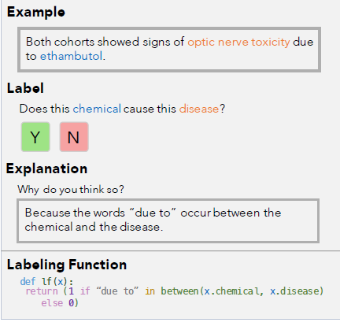
Explanation
标注label同时标注explanation
采用简单的基于规则的语义解析器
用label function来产生更多的标注
[ACL18]Training Classifiers with Natural Language Explanations
4

Slide 5
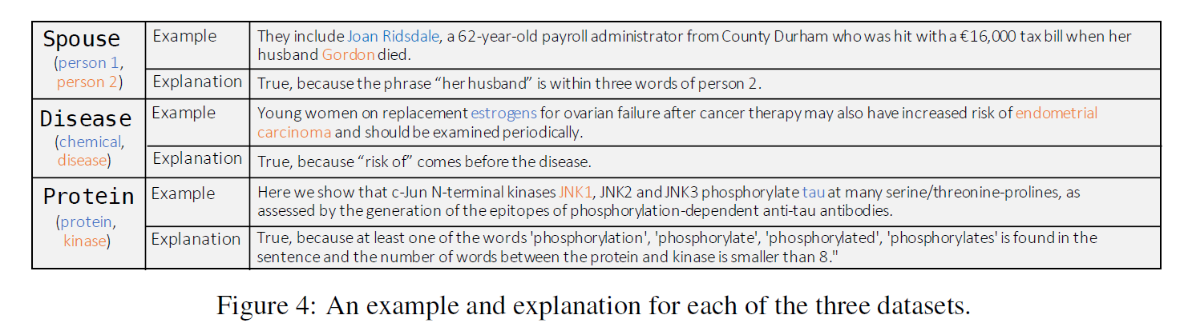
Example
5

Slide 6
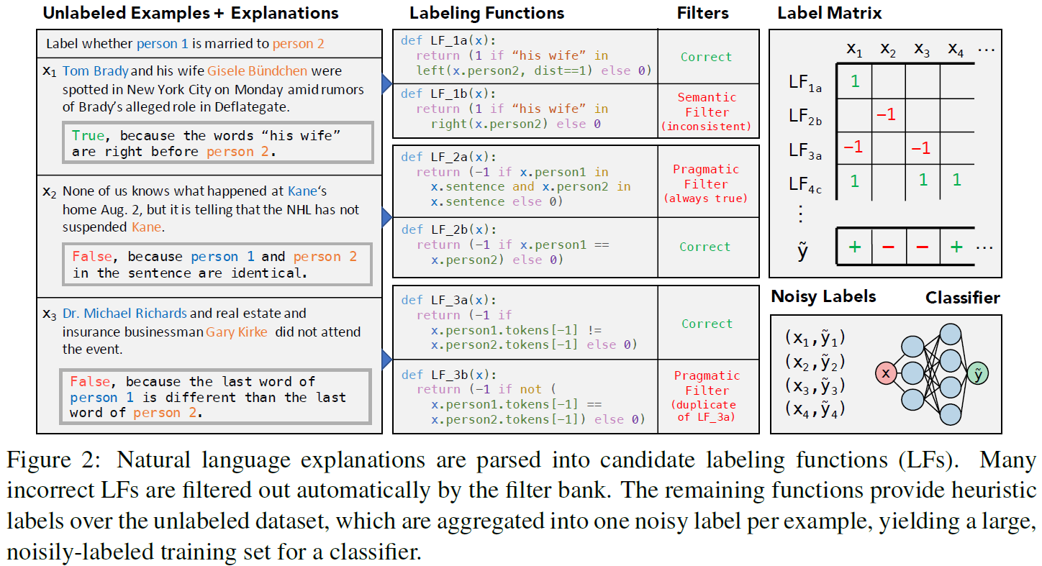
Overview
语义解析器：将explanation转换成logic function（LF）
6
Notes:
发展路线

Slide 7
Overview
filter bank：对LF进行筛选，删除尽可能多的错误LF，剩下的LF用来标记无标签数据来生产label
7
Notes:
发展路线

Slide 8
Overview
标签聚合器
8
Notes:
发展路线

Slide 9
Overview
判别模型
9
Notes:
发展路线

Slide 10
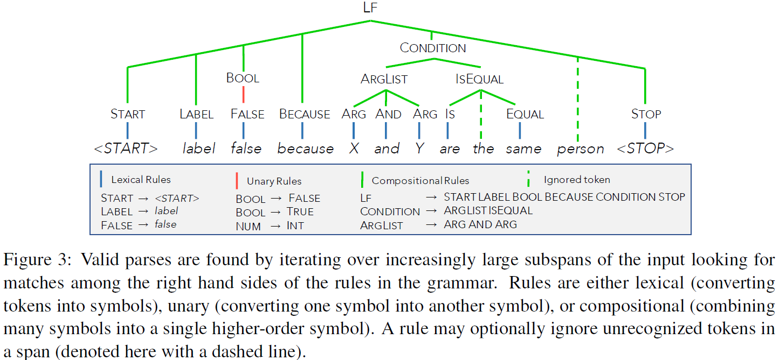
Parse
语义解析器：SippyCup
10
Notes:
发展路线

Slide 11
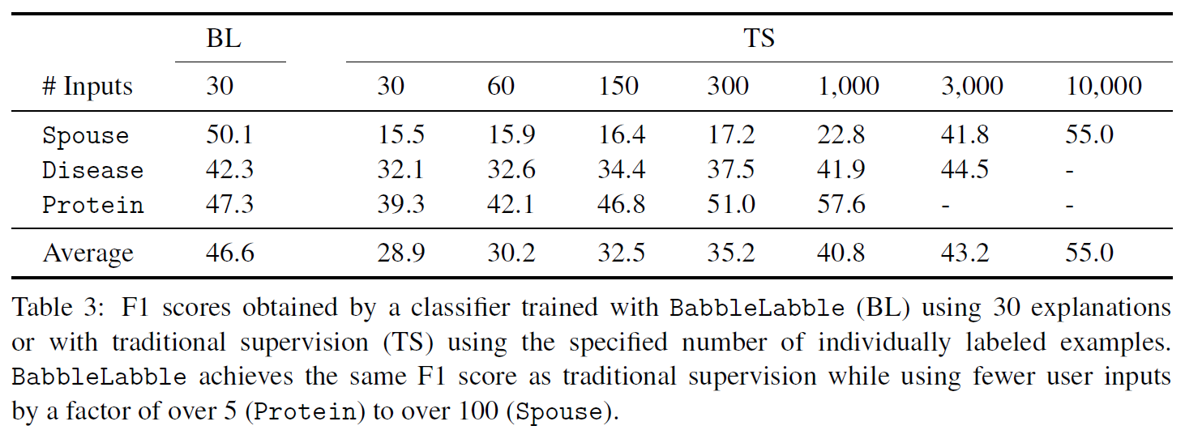
Explanation标注数据
标记数据较少时性能相对较好
11
Notes:
发展路线

Slide 12
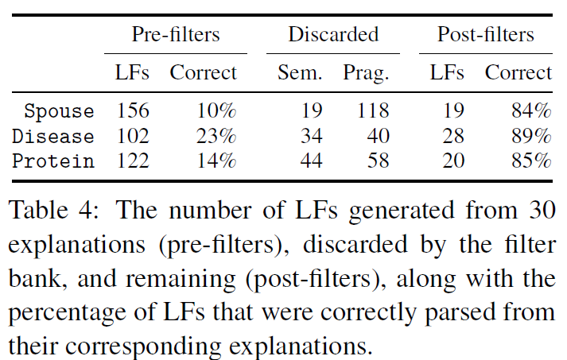
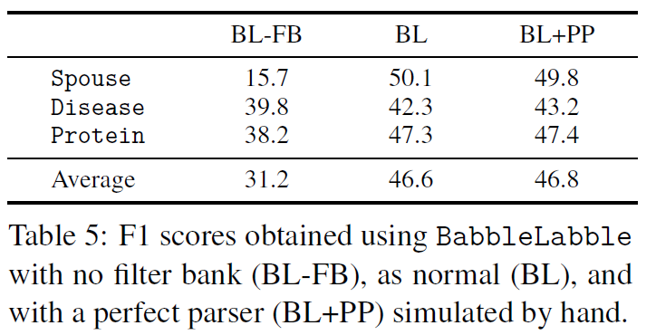
Data
Filter必要性
12
Notes:
发展路线

Slide 13
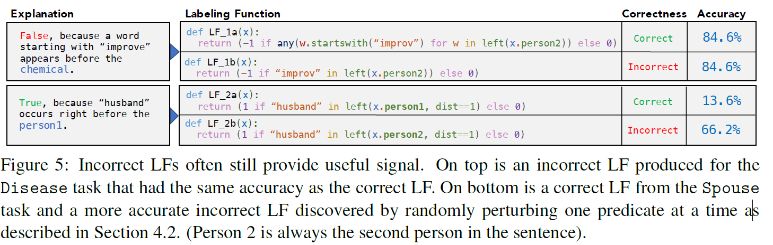
Explanation标注数据
13
Notes:
发展路线

Slide 14
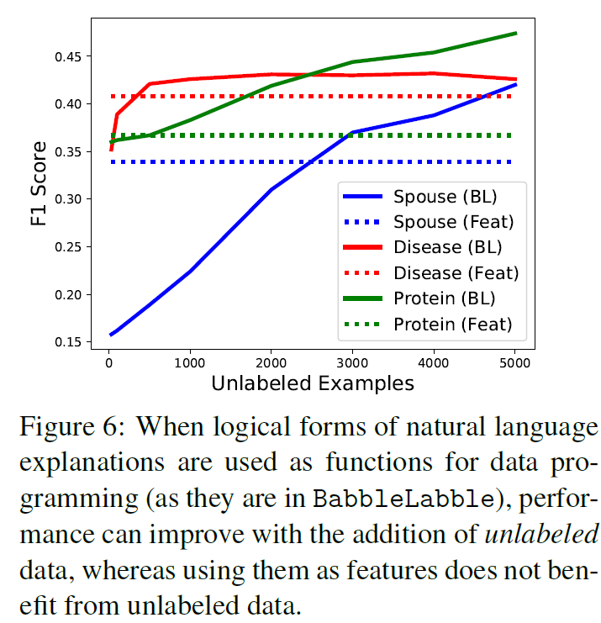
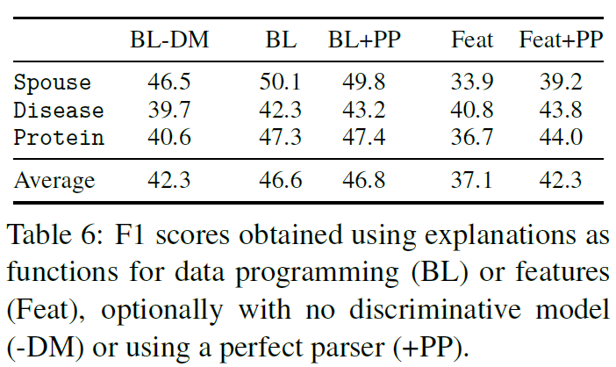
Explanation标注数据
Notes:
Feat将explanation作为额外的特征
BL-DM将聚合的标签直接作为分类器而不是送到判别模型中
BL我们的模型
BL+PP采用完美的语义解析器

Slide 15
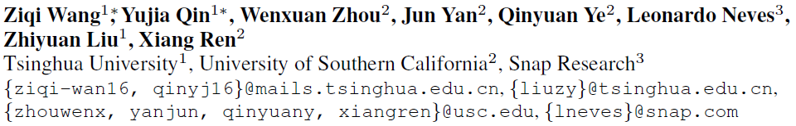
[ICLR20]LEARNING FROM EXPLANATIONS WITH
NEURAL EXECUTION TREE
15
Notes:
作者单位

Slide 16
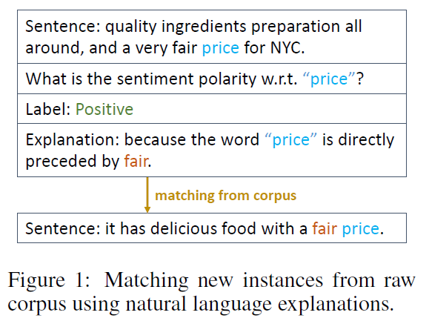
Approach
提出NExT框架,采用soft-match
[ICLR20]LEARNING FROM EXPLANATIONS WITH NEURAL EXECUTION TREE
16

Slide 17
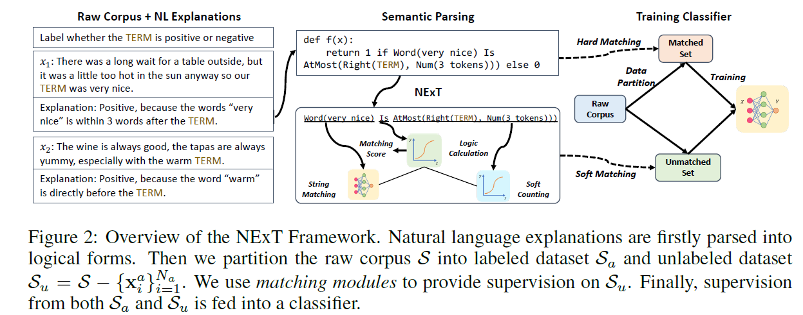
Approach
17

Slide 18
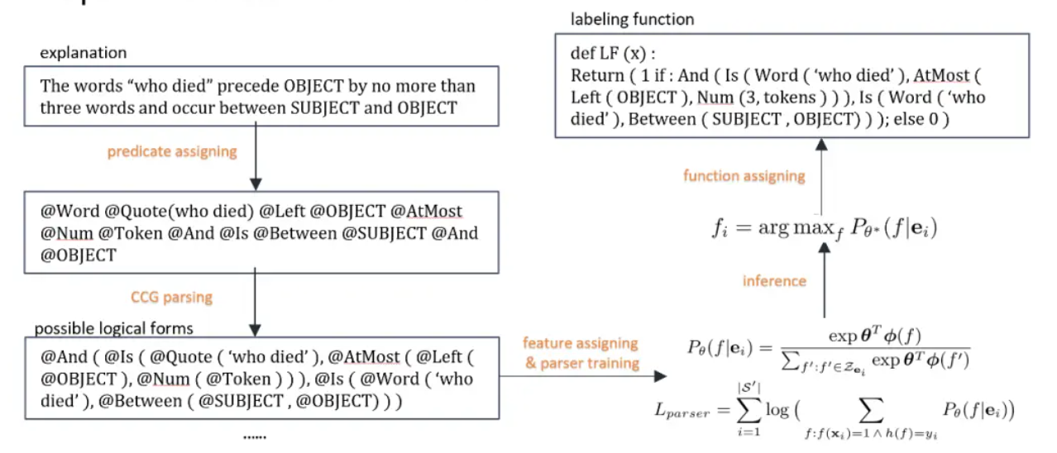
Approach
18
Notes:
把词和词组映射到预先确定的位置上
CCG文法生成非常多的logical form
建模最大化概率，选择概率高的logical form

Slide 19
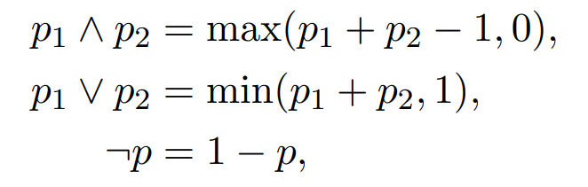
Approach
NExT
String Matching Module：计算相似度而不是精确匹配
Soft Counting Module：软化计数
Deterministic Function Module：用于不能软化的词
Logical Calculation Module：把节点和节点的概率组合在一起
19
Notes:
用的是现成的parsing

Slide 20
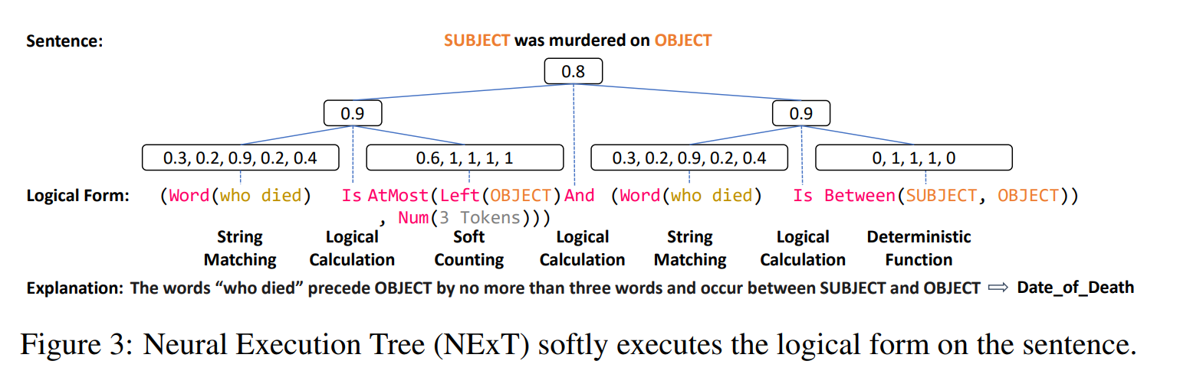
Approach
20
Notes:
用的是现成的parsing

Slide 21
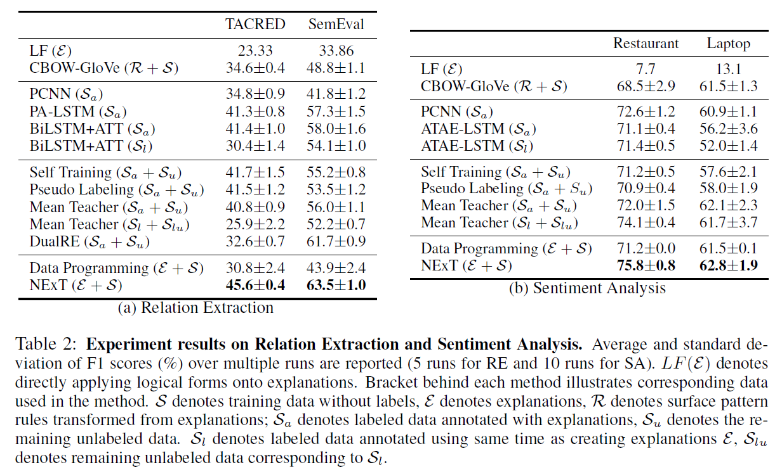
Expriment
21

Slide 22
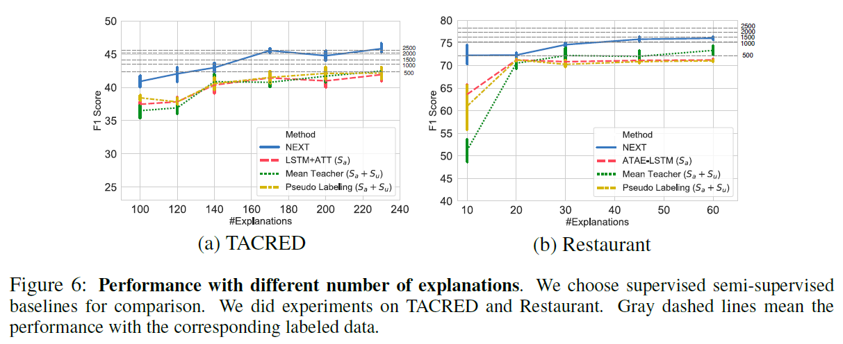
Expriment
22

Slide 23
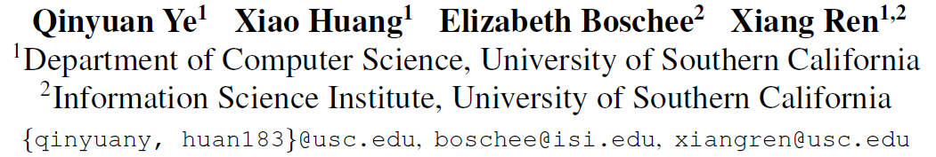
[EMNLP 20findings] Teaching Machine Comprehension with Compositional Explanations
23
Notes:
作者单位

Slide 24
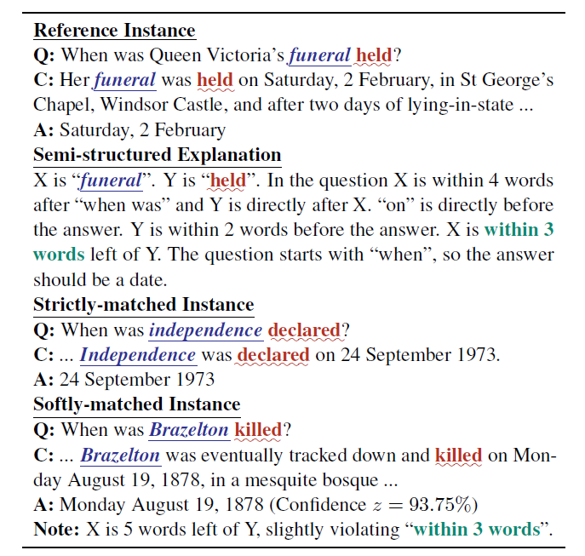
Introduction
使用少量的半结构化解释
从解释中提取结构化变量和规则，并组成neural module teachers，为训练下游MRC模型注解实例
24
Notes:
Background展开

Slide 25
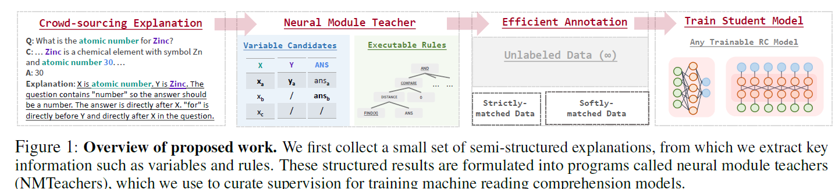
Approach
Hard_match → soft_match
联合训练teacher和下游分类器
25
Notes:
根据每个explanation来建立一个teacher
先进行严格匹配得到sa
没有匹配到的是su，然后放宽限制在进行匹配得到sp（有噪声还有置信度）

Slide 26
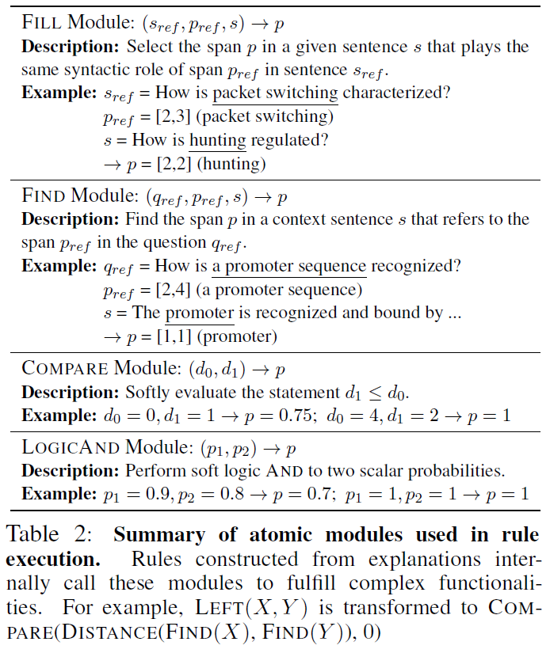
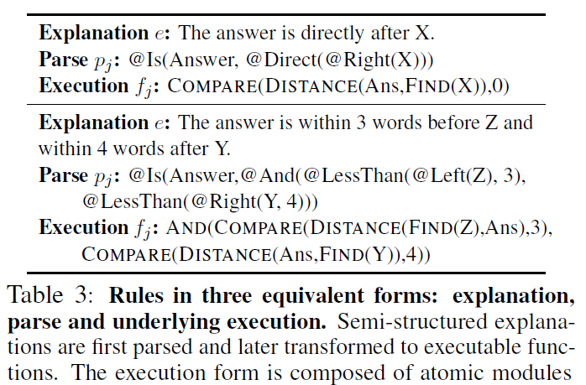
Introduction
26
Notes:
4个模块：
Fill：找到和以前最相近的问题
Find：找意义最相近的
Compare匹配距离相近的
Logicand匹配逻辑模块

Slide 27
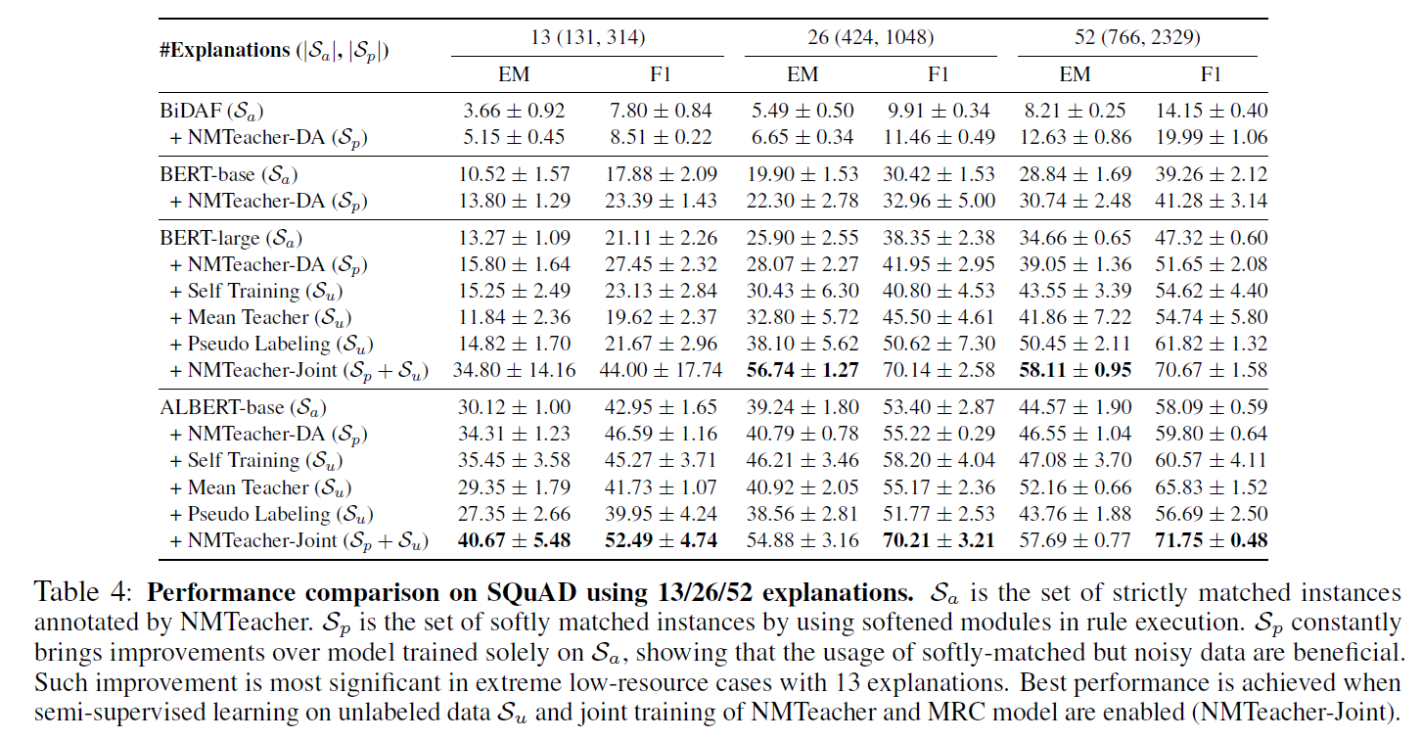
Expriment
27
Notes:
Background展开

Slide 28
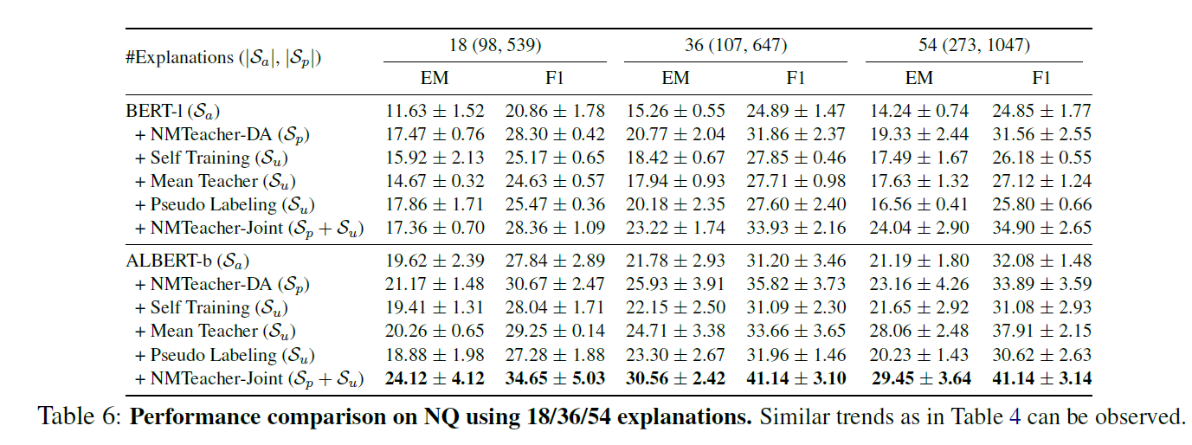
Expriment
28
Notes:
Background展开

Slide 29
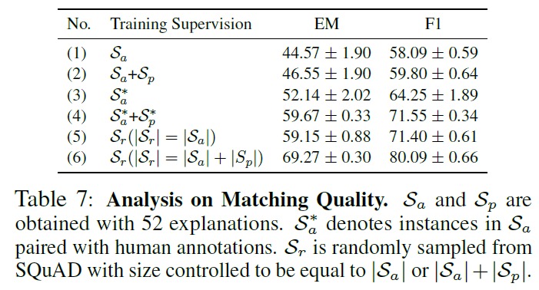
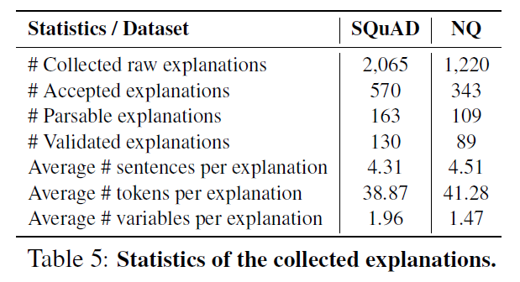
Expriment
29
Notes:
Background展开

Slide 30
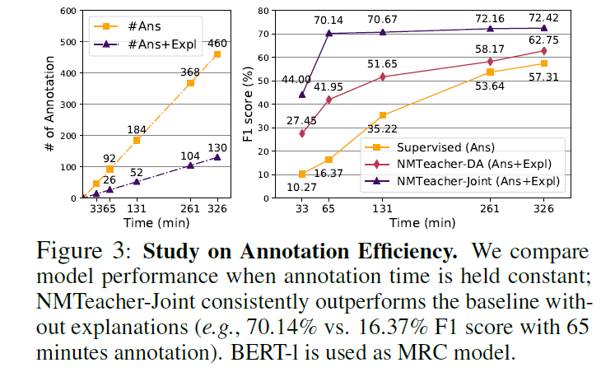
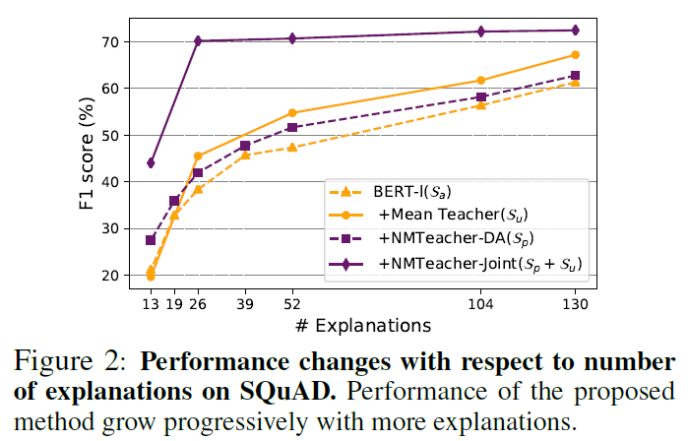
Expriment
30
Notes:
Background展开

Slide 31
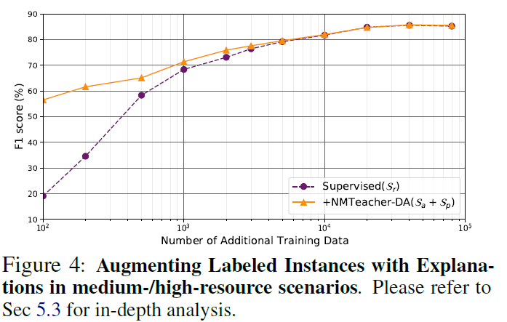
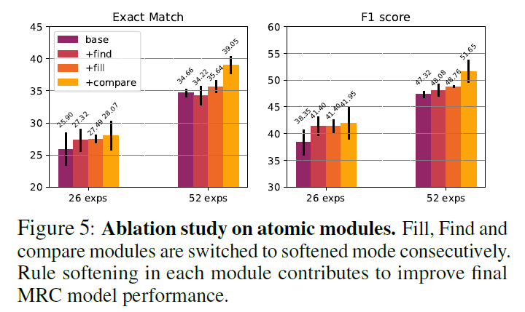
Expriment
31
Notes:
Background展开

Slide 32
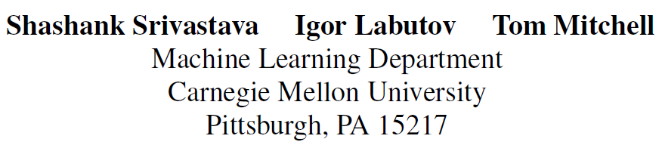
[EMNLP17]Joint Concept Learning and Semantic Parsing from Natural Language Explanations
32
Notes:
作者单位

Slide 33
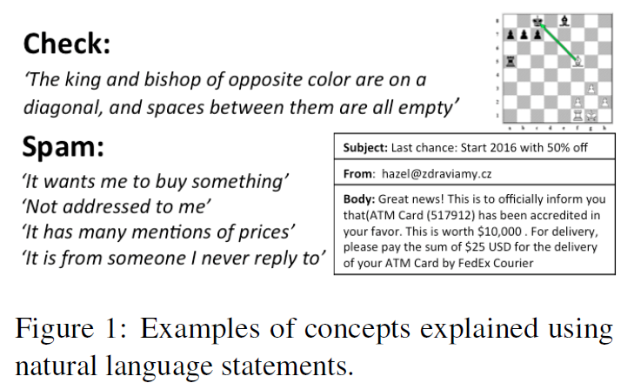
Motivation
Task：concept learning
Unnatural
Infeasible to acquire large quantities of labeled data
[EMNLP17]Joint Concept Learning and Semantic Parsing from Natural Language Explanations
33
Notes:
概念学习引入explanation+motivation

Slide 34
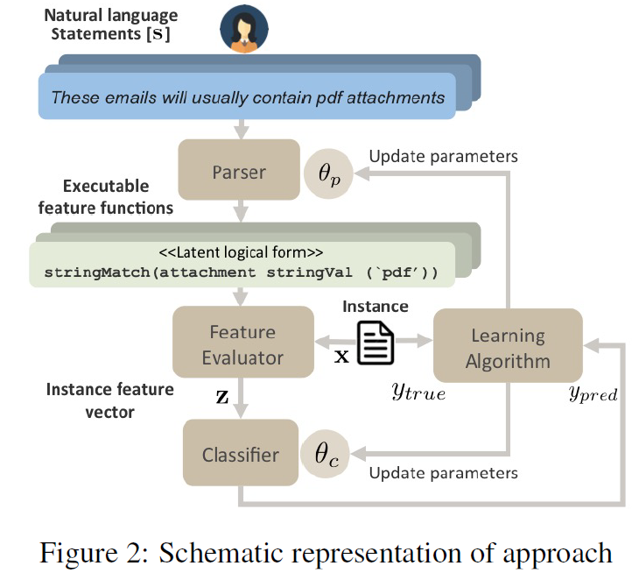
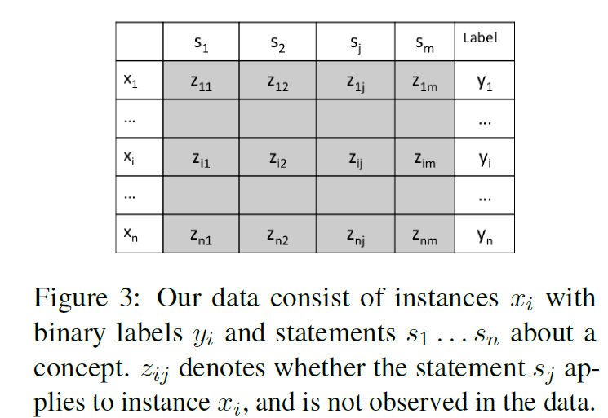
Approach
s defines some Boolean property over the instances X
jointly learn a classifier and a semantic parser while treating z’s as latent variables.
34

Slide 35
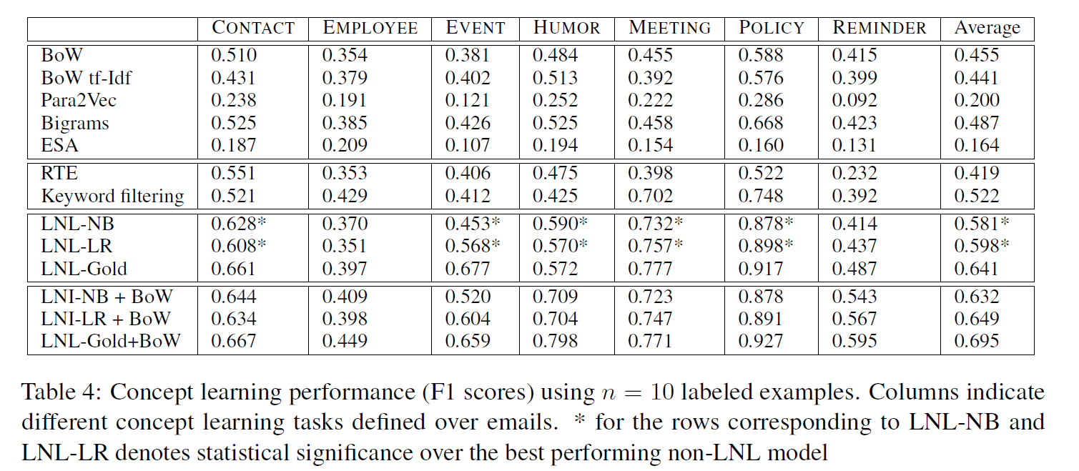
Experiment
35
Notes:
BoW: A logistic regression (LR) classifier over
bag-of-words representation of emails

Slide 36
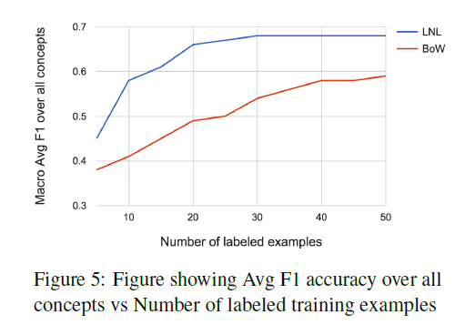
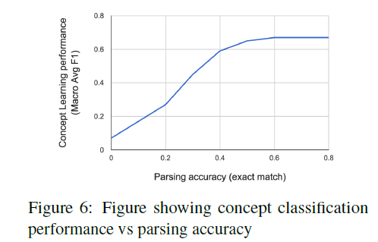
Experiment
36

Slide 37
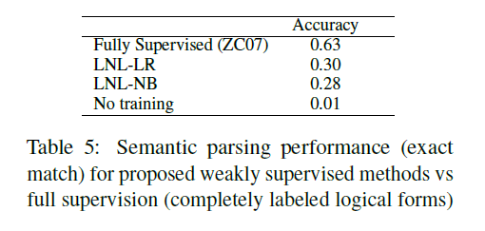
Experiment
37

Slide 38
Conclusion
自然语言解释可以利用监督学习方法来显著提高泛化
38

Slide 39
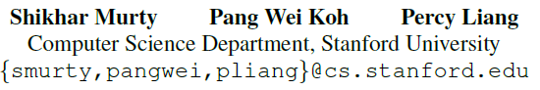
[ACL20] ExpBERT: Representation Engineering with
Natural Language Explanations
39
Notes:
作者单位

Slide 40
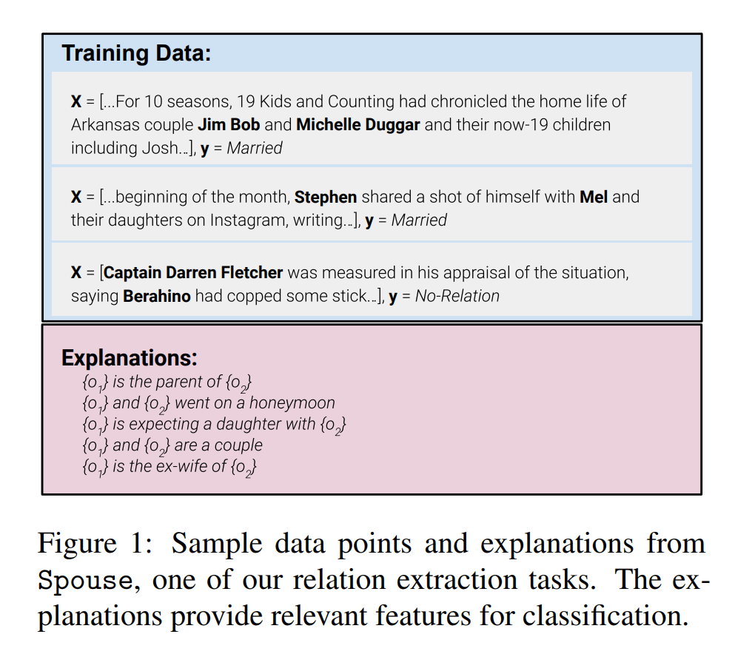
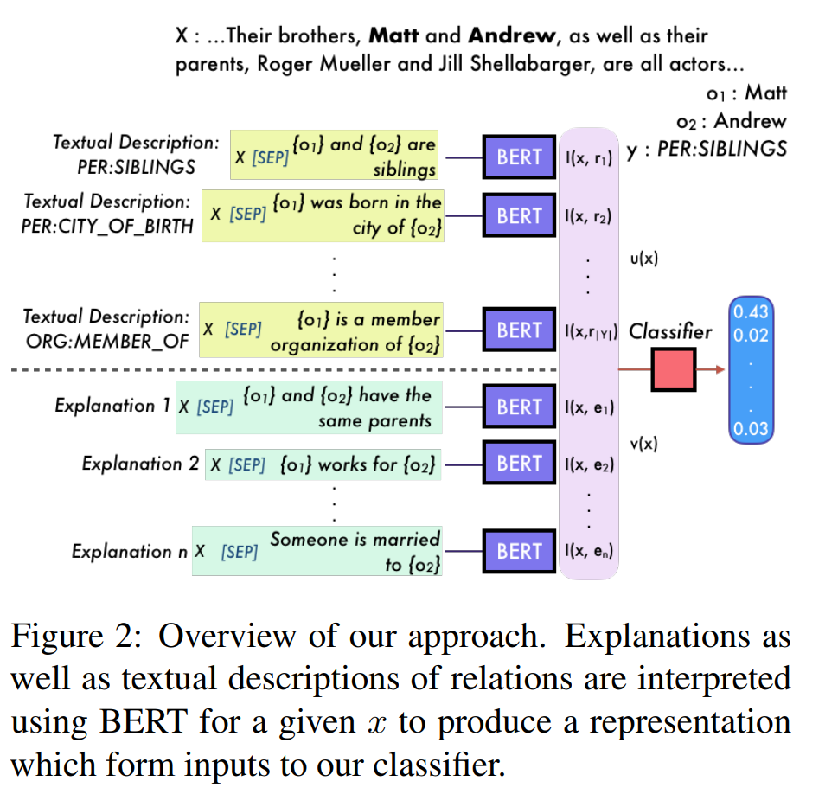
Approach
[ACL20] ExpBERT: Representation Engineering with Natural Language Explanations
40
Notes:
Background展开

Slide 41
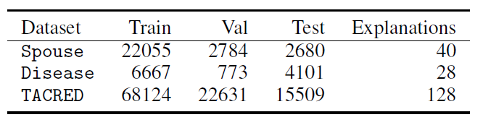
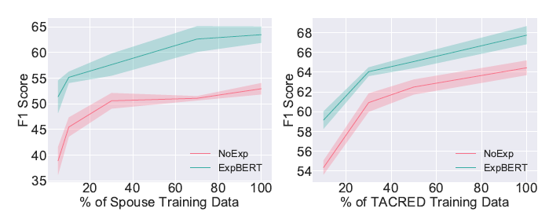
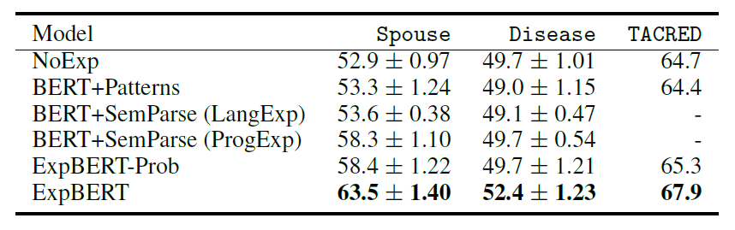
Experiment
41

Slide 42
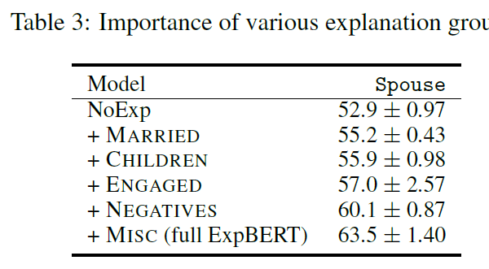
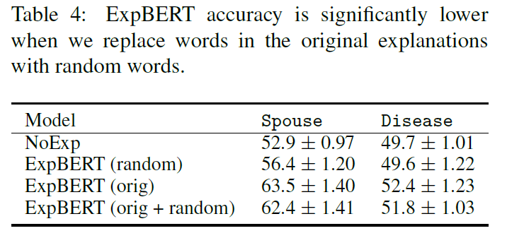
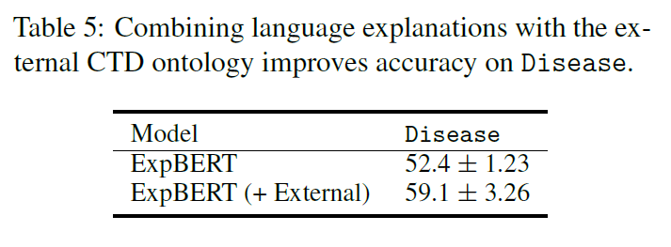
Experiment
Explanation 的有效性
42

Slide 43
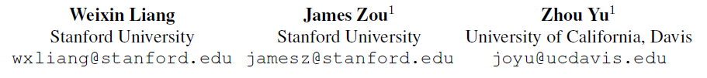
[EMNLP20] ALICE: Active Learning with Contrastive Natural Language Explanations
43
Notes:
作者单位

Slide 44


Background
[EMNLP20] ALICE: Active Learning with Contrastive Natural Language Explanations
44
Notes:
左上角显示的是一只环嘴鸥的示例图像。在其他三张图(A)， (B)， (C)中，哪一张不是环嘴鸥，而是加利福尼亚鸥?给出自然语言的解释“环嘴海鸥的喙尖附近有一个黑色的环 “加利福尼亚海鸥下颌骨顶端附近有一个红斑”，更容易发现(a)是正确的选择

Slide 45

approach
Selects b most confusing class pairs to query
45

Slide 46

Explanation
Query only contains text information
Parse the natural language explanations
46

Slide 47
explanation
Extrated knowledge from explanation
rule-based semantic parser
Grounded patches
47

Slide 48
Neural Architecture Morphing
48

Slide 49

Neural Architecture Morphing
49

Slide 50
Background
50

Slide 51

Bird Species Classification Task
Figure 5: Comparing the performance gain of adding contrastive natural language explanations and adding training data points on bird species’ prediction accuracy. Empirically, adding 1 explanation leads to similar performance gain as adding 30 labeled training data points.

Slide 52


Social Relationship Classification Task
52

Slide 53
Thanks
Q & A

Slide 54

[NeurIPS18] e-SNLI: Natural Language Inference with
Natural Language Explanations
54
Notes:
作者单位

Slide 55

Background
[NeurIPS18] e-SNLI: Natural Language Inference with Natural Language Explanations
55

Slide 56
Approach
在SNLI的基础上标注一个新的数据集e-SNLI(加入人工解释)
五个观点:
依靠SNLI中的浅层信息提供正确标签的模型将无法轻易地去提供正确的解释
预测一个标签并为预测的标签产生一个解释
根据产生的解释去预测标签，准确率上升一点点
用explanation可以学习更好的句子表示
转换到NLI的其他领域的语料库
56
Notes:
第一个是主要观点
第二个是想证明确实学到的是浅层知识

Slide 57
Approach
依靠SNLI中的浅层信息提供正确标签的模型将无法轻易地去提供正确的解释PREMISEAGNOSTIC
只给前提不给假设然后去分类，依然可以达到67%
57
Notes:
想要证明解释有用

Slide 58

Approach
预测一个标签并为预测的标签产生一个解释PREDICTANDEXPLAIN
准确率：84.01%
perplexity：10.58
BLEU：22.4
人工：34.68%
58
Notes:
目的是证明整个网络的决定是正确的。想看看SNLI上使用的典型架构是如何适应的，以自然语言证明它的决定。
为了在标签上设置解释条件，所以将lable房子explanation之前。

Slide 59

Approach
根据产生的解释去预测标签EXPLAINTHENPREDICT
先生成高质量解释再去预测标签
59
Notes:
For predicting an explanation given a pair of (premise, hypothesis), we first train a simple seq2seq model that we call EXPLAINTHENPREDICTSEQ2SEQ.
Secondly, we train an attention model, which we refer to as EXPLAINTHENPREDICTATTENTION. We use the same encoder and decoder as in EXPLAINTHENPREDICTSEQ2SEQ,
and we add two identical but separate attention modules, over the tokens in the premise and hypothesis.

Slide 60

Approach
用explanation可以学习更好的句子表示
Model：和step2使用的model是一样的。baseline有两个，一个是没有decoder的，还有一个是对假设和前提进行decoder
60
Notes:
For predicting an explanation given a pair of (premise, hypothesis), we first train a simple seq2seq model that we call EXPLAINTHENPREDICTSEQ2SEQ.
Secondly, we train an attention model, which we refer to as EXPLAINTHENPREDICTATTENTION. We use the same encoder and decoder as in EXPLAINTHENPREDICTSEQ2SEQ,
and we add two identical but separate attention modules, over the tokens in the premise and hypothesis.

Slide 61

Approach
TRANSFER: Transfer without fine-tuning to out-of-domain NLI
精度提升很小
61
Notes:
For predicting an explanation given a pair of (premise, hypothesis), we first train a simple seq2seq model that we call EXPLAINTHENPREDICTSEQ2SEQ.
Secondly, we train an attention model, which we refer to as EXPLAINTHENPREDICTATTENTION. We use the same encoder and decoder as in EXPLAINTHENPREDICTSEQ2SEQ,
and we add two identical but separate attention modules, over the tokens in the premise and hypothesis.

